Slide 1
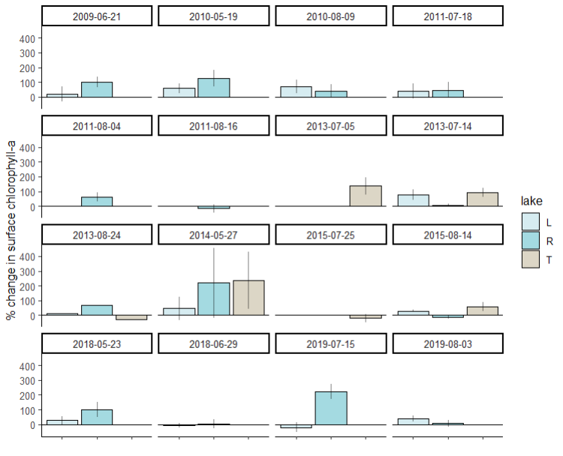
Goal: explain variation in percent change in chlorophyll during heatwaves
Error bars are standard deviation
Of the five percent changes we averaged

Slide 2
Gravimetric zooplankton

Slide 3
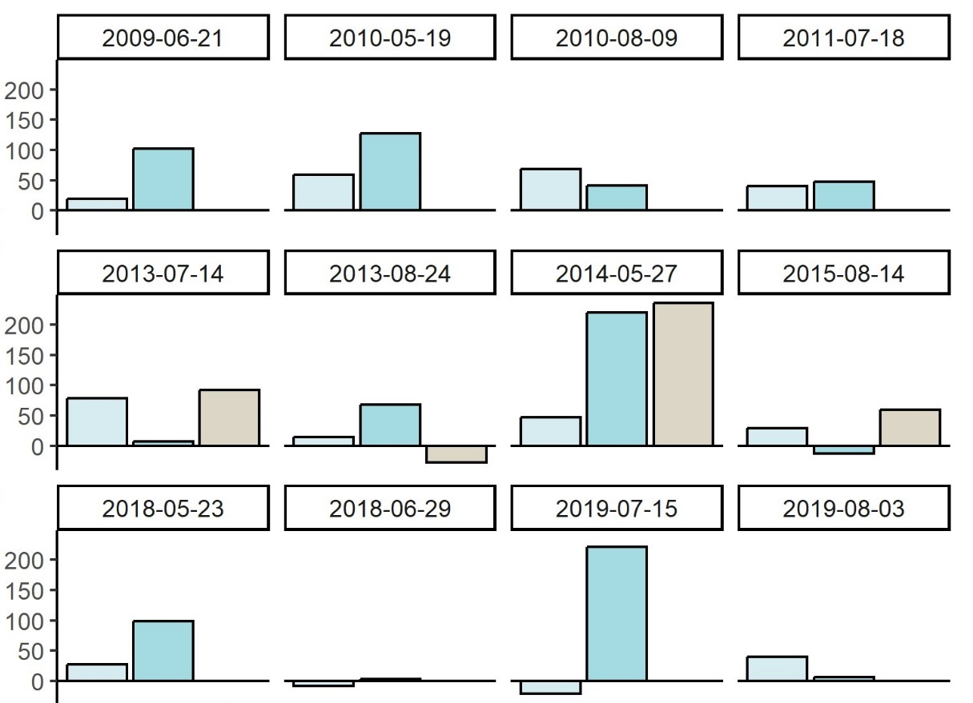
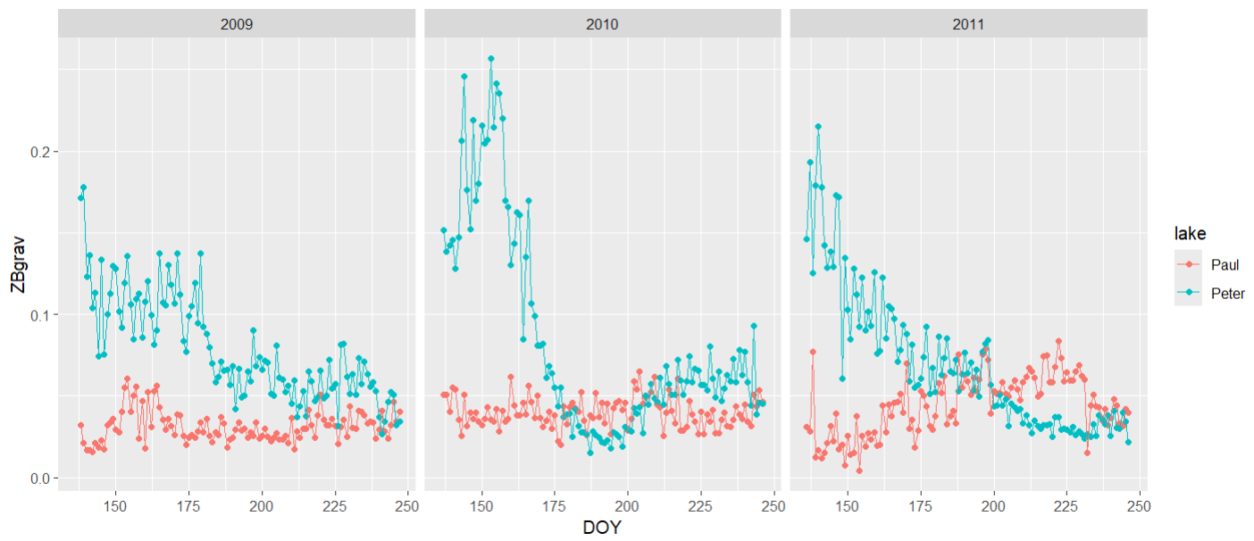
Gravimetric zooplankton
Notes:
Gravimetric zooplankton

Slide 4
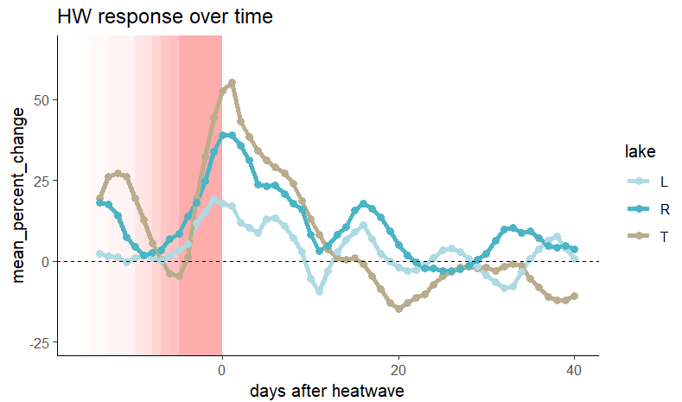
Percent change in chlorophyll relative to heatwave timing -- ALL YEARS
Percent change in chlorophyll over time, relativized to the end date of the heatwave and averaged over all heatwave events for each lake. Each heatwave is represented by a pink box (heatwaves range in duration from 5 to 16 days). Each point represents the percent change over the preceding 7 days. A point at the end of the heatwave window, then, (where chlorophyll percent change is highest), represents the time period of the heatwave. When I get the distributions of percent changes, I take the five points from day 0 after the heatwave, onward.

Slide 5
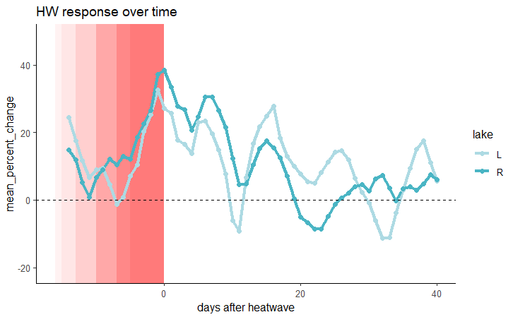
Percent change in chlorophyll relative to heatwave timing -- 2008 to 2011

Slide 6
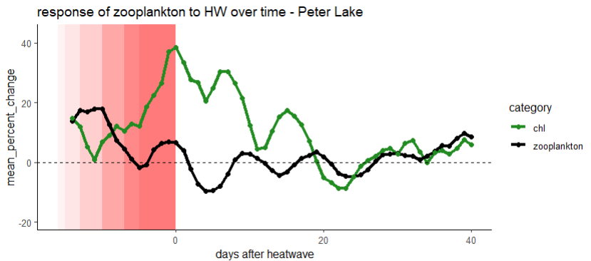
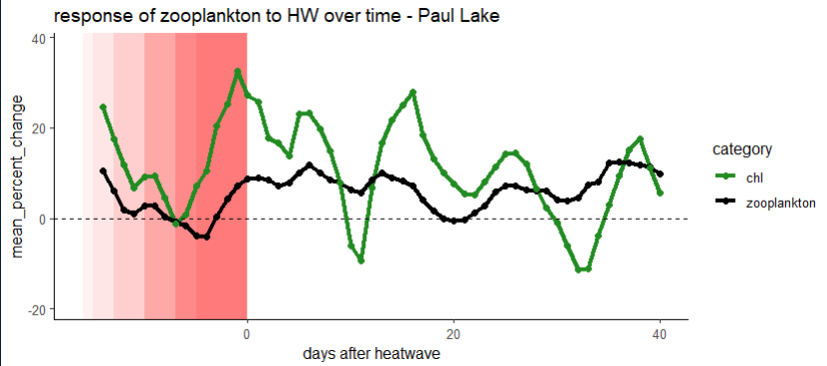
Here, I applied the same rolling slopes analysis to zooplankton that I applied to chlorophyll. There is a dip in the percent change in zooplankton corresponding to the mean start date of the heatwaves

Slide 7
Routines Zooplankton

Slide 9
Conceptual figure
Heatwave
Zooplankton
Chl

Slide 10
Abs change in Daphnia before heatwave to during
Change from during heatwave to after heatwave

Slide 11
Questions
Biomass of zooplankton in 2018 and 2019 was magnitudes lower than the other years
The positive changes in zooplankton came at times with the lowest biomass recorded before the heatwave, early in the spring—the 200% increase in zooplankton could just be noise in the data
Is it just Daphnia and Holopedium that make up the majority of grazing?

Slide 12
How to calculate error bars?
Standard deviation of the percent changes included in the estimate, divided by the sqrt(n) to get standard error
OR
Plot with just the standard deviation of the percent changes included
OR
Some sort of measurement of average error from the regressions we fit

Slide 13
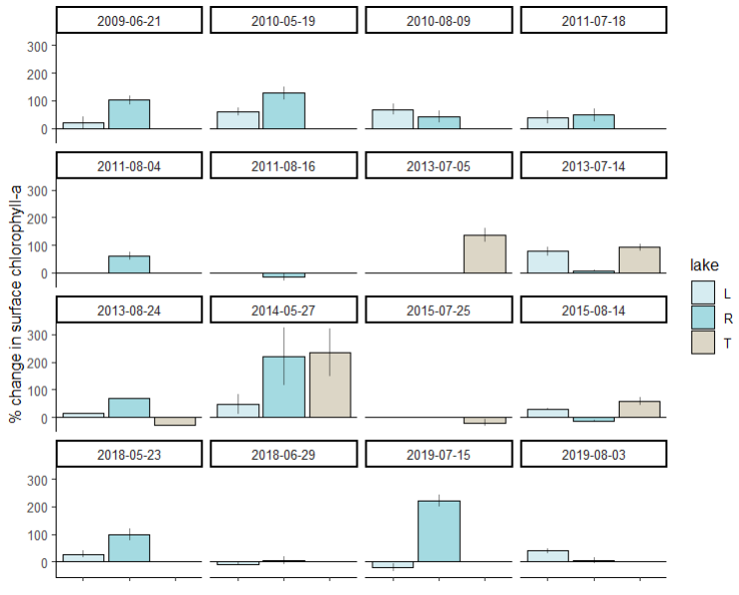
Standard Deviation
Standard Error
Notes:
No SD for 2013 because only two slopes were aggregated, these are at the end of the dataset

